Slide 1
Steering In Self Driving Cars Using Deep Learning Algorithm
Submitted by
Maria Anson.A
1715016
Computer Science Department
Guided by
Dr.L.Rasikannan
Assistant Professor
Computer Science Department

Slide 2
Outline
Self Driving Cars
Level of Autonomy
Machine Learning vs Deep Learning
Requirements & Libraries
Block Diagram
Dataset & Processing
Architecture
General Working
Fine Tuning
Training
Simulation
Conclusion

Slide 3
Self Driving Cars
Self-driving vehicles are cars or trucks in which human drivers are never required to take control to safely operate the vehicle.
Also known as autonomous or “driverless” cars, they combine sensors and software to control, navigate, and drive the vehicle.
So to make the vehicle autonomous one of the vital part is steering through different terrains without the intervention of human.
This can be achieved by using a dash camera placed at the front of the car.
The video feed is analysed and respective steering angles are generated which are used to actuate the steering wheel.

Slide 4
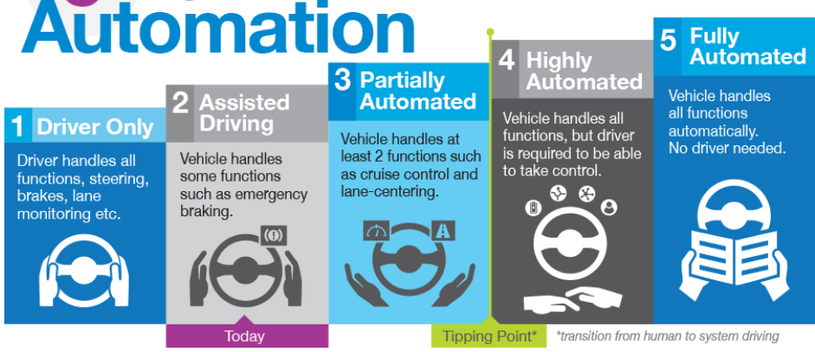
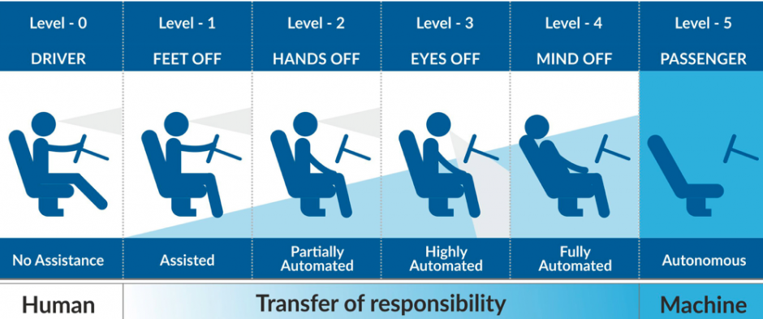
Level of Autonomy
Level 3 is the current autonomy level in production whereas Tesla cars support level 4 autonomy.
Level 5 is still in it’s conceptual face.

Slide 5
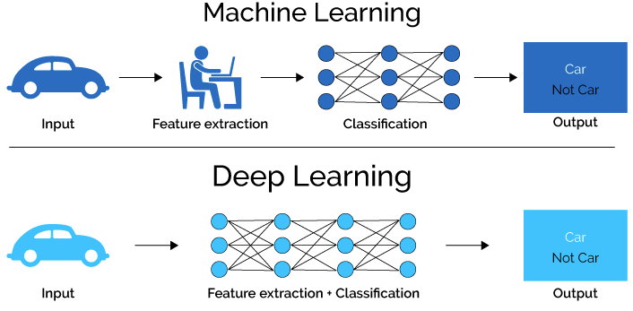
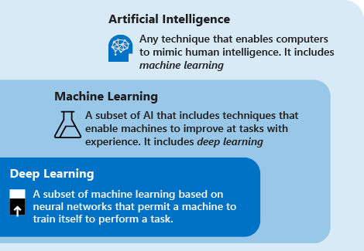
Machine Learning Vs Deep Learning
We adopt the deep learning approach for the project

Slide 6
Requirements
A high quality camera.
A huge amount of image data from the video recorded by the high quality camera for achieving the accuracy using deep learning approach.
A high computing gpu enabled system to train the model.
Prerequisite knowledge of Python programming language.
Understanding of working of convolutional neural network to perform hyperparameter tuning.
To achieve the task in real word, we need a mechanical actuation for steering.

Slide 7
Libraries
Opencv 4.5.1
Numpy 1.20.1
Scipy 1.4.1
Sklearn 0.24.1
Keras 2.3.1
Tensorflow 2.0.0
Matplotlib 3.3.4
Pickle
Os

Slide 8
Block Diagram
Image capturing using dash camera
RGB to HSV
Conversion
Data Processing using Pickle
Fine Tune and check the performance
Train a Dave-2 CNN
Simulation using the model

Slide 9

Dataset
The dataset contains 63,826 images which are obtained from the video of a dashcam which was recorded in Rancho Palos Verdes and San Pedro, California and a text file with respective angles for each image.
Among the images 44677 images are used for training and 19148 images for validation which achieved a minimum loss of 0.22 mean squared error.

Slide 10
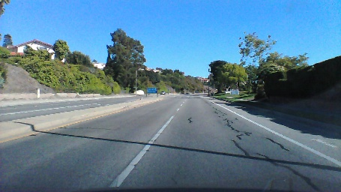
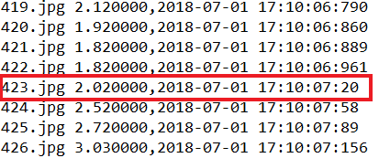
Dataset
This is a sample image from the dataset which is 423.jpg
The label for the image is found in a text file with the respective angle of steering for the particular image.
The steering angle for each frame is recorded while creating this datset

Slide 11
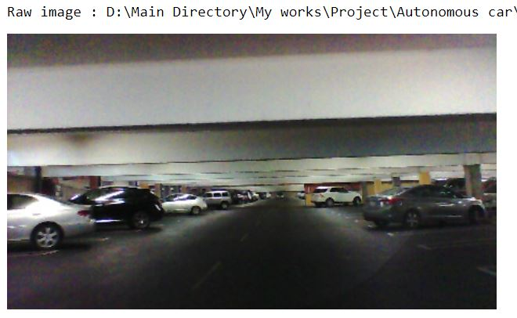
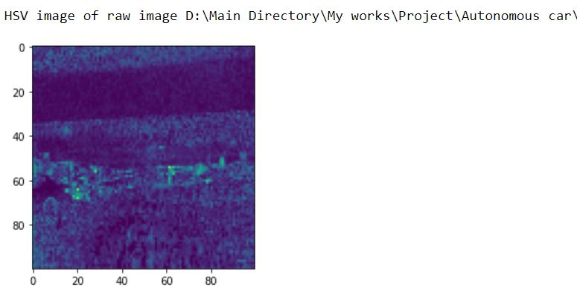
Data Preprocessing
The image is converted into a (100,100,3) array so that every image that enters the model follows the same format
HSV or Hue Saturation Value is used to separate image luminance from color information.
HSV also used in situations where color description plays an integral role. The images are converted into HSV.

Slide 12
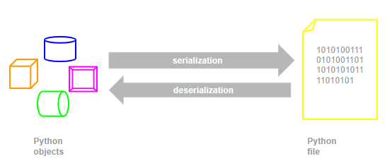
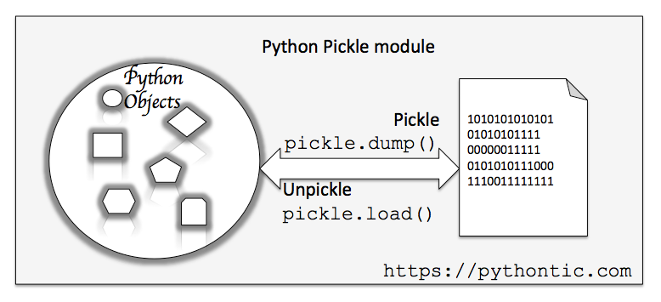
Data Processing
The transformed data which is image size and in HSV format is stored in a pickle format.
Pickle format allows processing and accessing the data much faster
It can also be easily converted into a numpy data type which is converted into tensor data type at the time of model running.

Slide 13
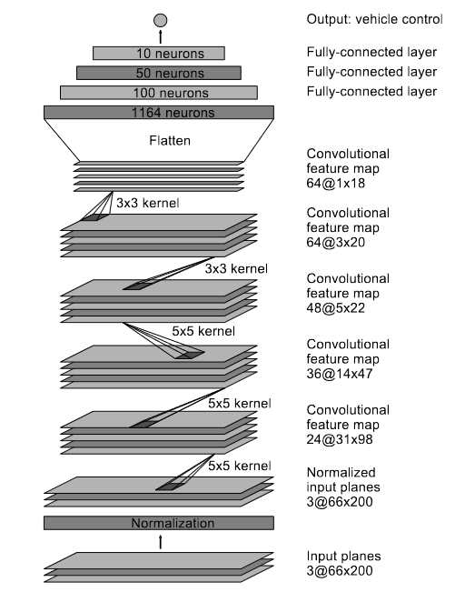
Architecture
The architecture of this convolutional neural network is called Dave-2 which is inspired from the paper published by Nvidia corporation.
It used deep layers to extract more features from the image, so that precise steering angles can be generated
This architecture has a total of 747,105 parameters.

Slide 14
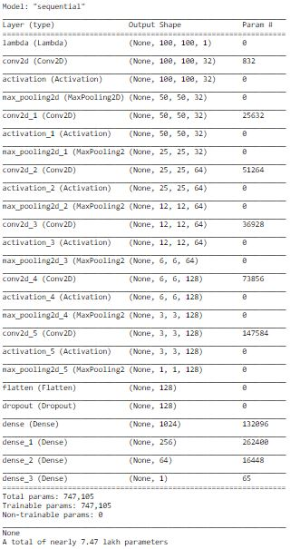
Architecture
This architecture has a total of 747,105 parameters which are tuned to generalize for the entire images in the dataset to get optimal solution for every input

Slide 15
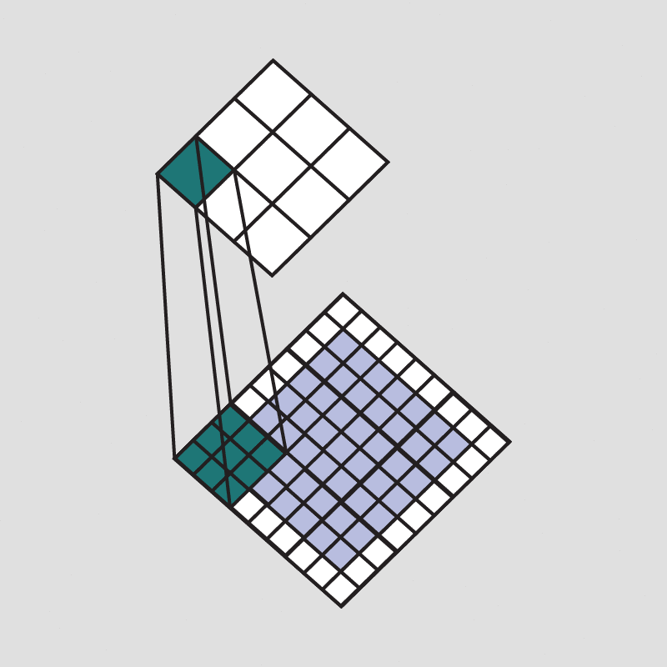

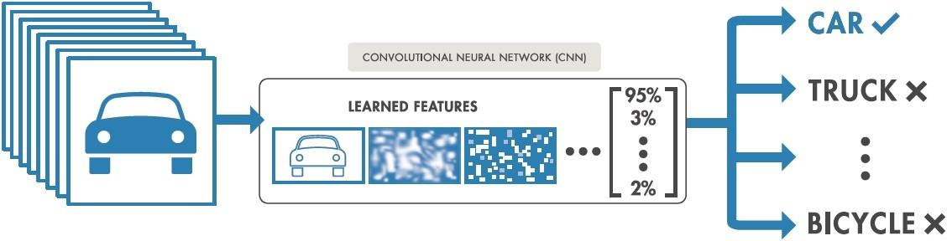
General Working
A convolution is the simple application of a filter to an input that results in an activation. Repeated application of the same filter to an input results in a map of activations called a feature map, indicating the locations and strength of a detected feature in an input, such as an image.

Slide 16
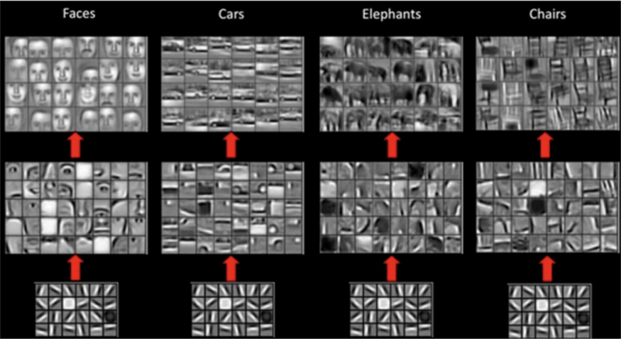
General Working
Each CNN layer learns filters of increasing complexity.
The first layers learn basic feature detection filters: edges, corners, etc
The middle layers learn filters that detect parts of objects. For faces, they might learn to respond to eyes, noses, etc
The last layers have higher representations: they learn to recognize full objects, in different shapes and positions.

Slide 17
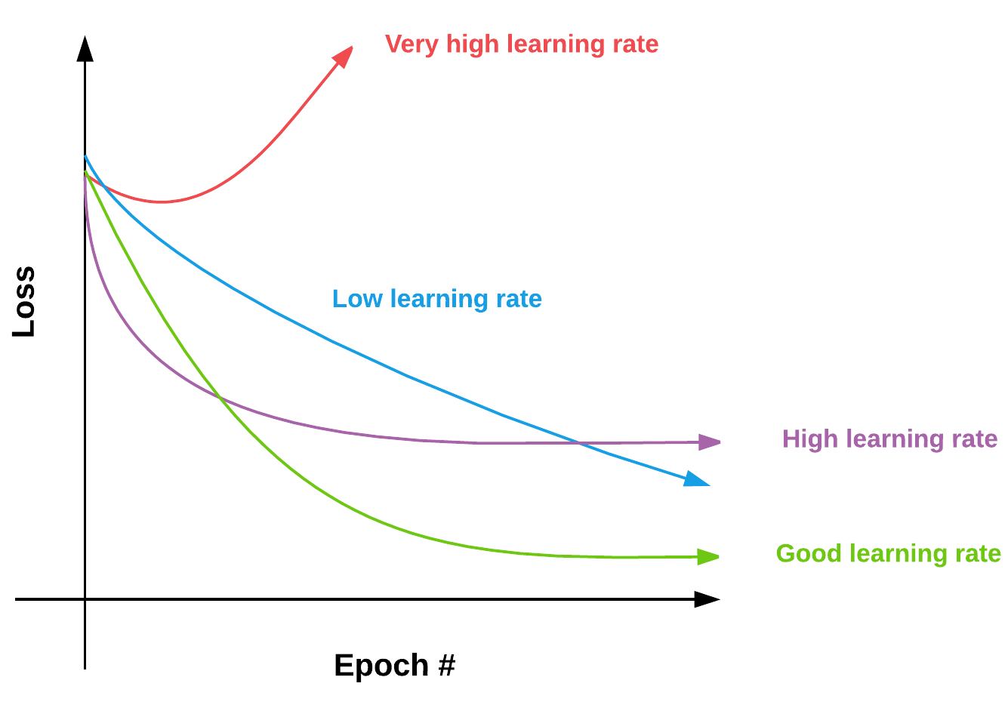
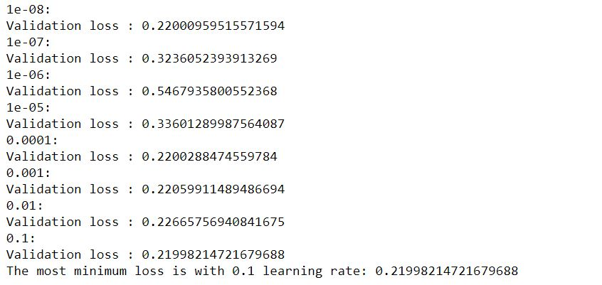
Fine Tuning
The model is trained for different hyperparameter and we got 0.1 learning rate as the optimal solution for the model.

Slide 18
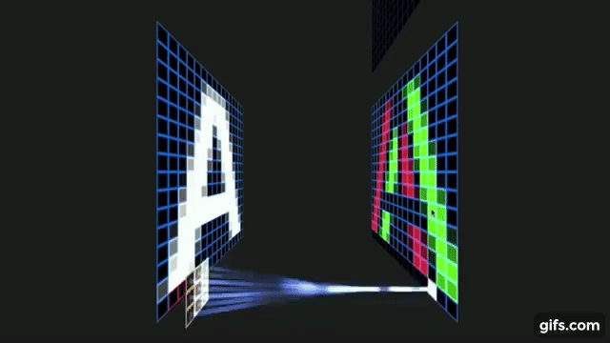
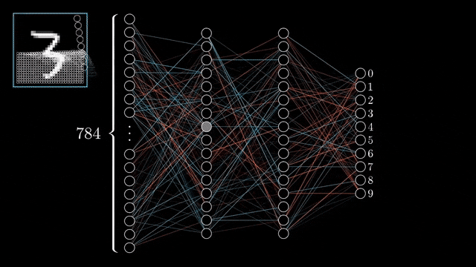
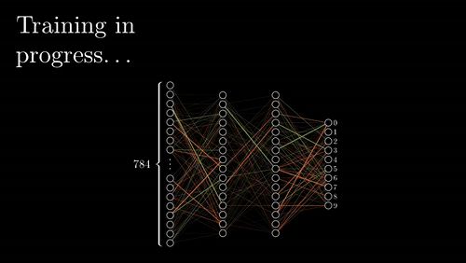
Training

Slide 19
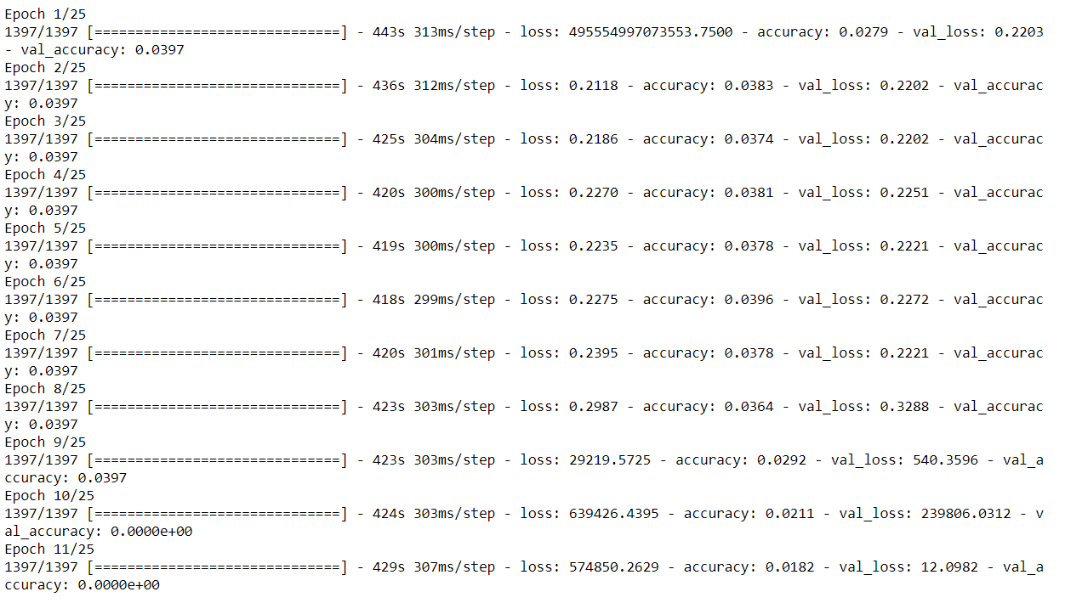
Training
One epoch is when an entire dataset is passed both forward and backward through the neural network only once.
One batch is a set of images that is parsed at a time.

Slide 20
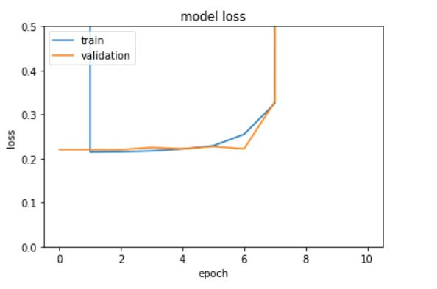
Training curve
The model is trained using early stopping in which the validation loss is monitored to get the optimal solution in which we get 0.21 mean squared error.

Slide 21
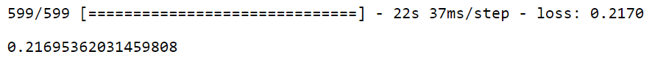
Validation
The model is validated on data that is not used for training, so that the model does not overfit the data.
This step is done to know how much the model has generalised to other that has not been used in training.
We achieved a minimum validation loss of 0.2169

Slide 22
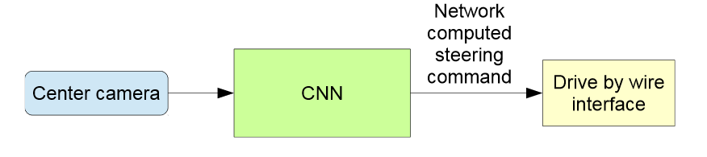
Output
The trained network is used to generate steering commands for the image from a single front-facing center camera.
The output is sent to an actuator which actuates the human steering movement automatically

Slide 23
Simulation
The live feed of a camera is captured and it is converted into images.
The image is parsed through the convolutional neural network model we have trained.
These images are parsed at each individual frame level
The output which is the steering angle is used to rotate the steering wheel image using the cv2 functions.
Each output is printed to the prompt screen to understand the output of the model
The live video is played so that we can make sense that the model actually works

Slide 24
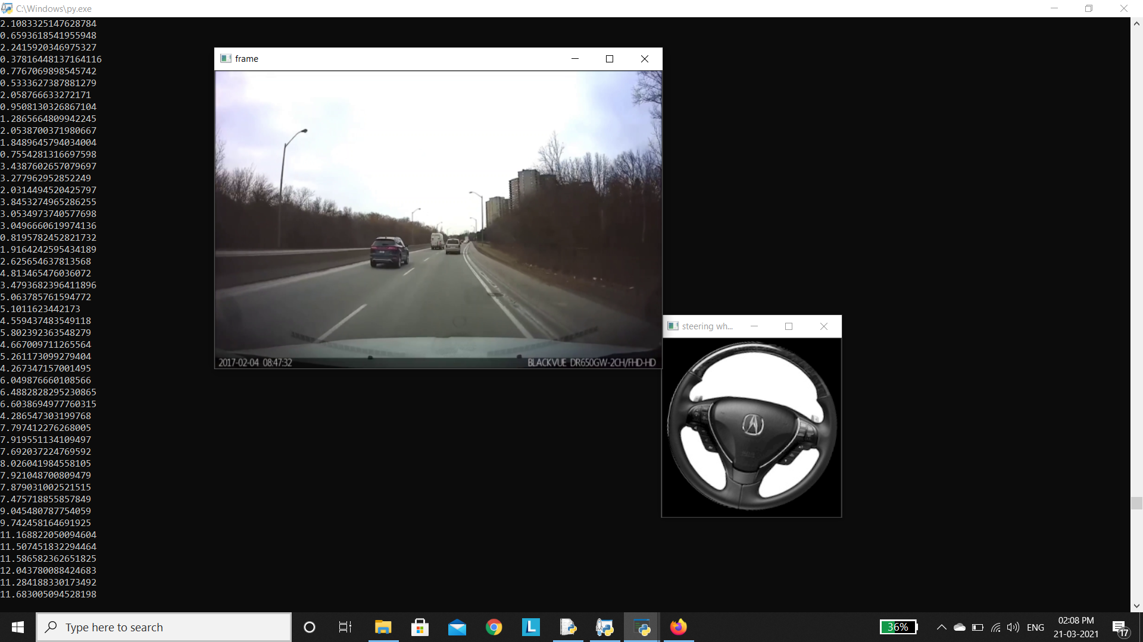
Simulation

Slide 25
Conclusion
Our model is able to learn the entire task of lane and road following without manual decomposition into road or lane marking detection, semantic abstraction,path planning, and control.
The CNN is able to learn meaningful road features from a very sparse training signal (steering alone). The system learns for example to detect the outline of a road without the need of explicit labels during training.
The robustness of the method and the internal processing steps in visualization will give a clear idea.

Slide 26
Further improvements
Often driving steering angles depend upon the previous angle actuated by the human, so feasibility of the models that can remember previous states like LSTM, GRU, etc.
A separate CNN should be trained for traffic sign classification which will be able to give signals to the autonomous car when to stop, what speed to follow, etc.
Also some warning signals like steep road ahead, curvy road ahead can be used to alert the driver as well as modify the steering angle which can give a heads up to our end to end approach.

Slide 27
THANK YOU ALL !!!

